Slide 1
Computer Vision
AI Production

Slide 2

Plan
Production ready
Quick app
Container
The GAFAM
Vision API
AutoML
Summary

Slide 3
Production Ready
The forgotten step

Slide 4


Production ready
Web Server
Computation Server
Model
API
Notebook
___
___
___
___
___
Copy
Model
Server constraints
API output format
Scalability

Slide 5
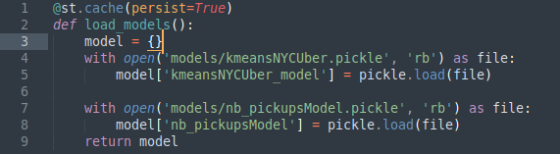

Production ready: quick app
Advantages:
Easy
All python
No front-end experience required
Components (community)
One click deployment
Code exemple
Limited app possibilities
Security
New
Hard to customize
Scalability

Slide 6
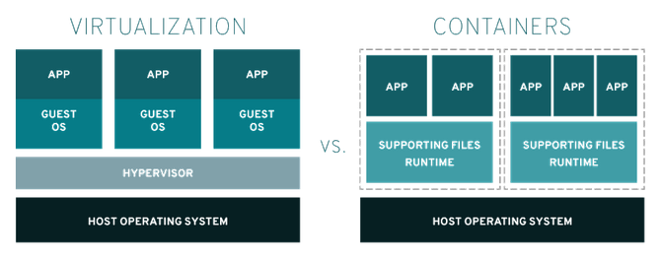

Production ready: Container
APP
APP
APP
Container:
Model
Advantages:
Faster
Lighter
Easier / reproducible deployments
Web Server

Slide 7
The GAFAM
Think outside the...

Slide 8



Vision API
Black box:
Pre-trained models
Object / content detection
Emotions
Facial recognition
OCR
Images & Videos
Pay as you go

Slide 9
AutoML
Semi-black boxes:
Train your own model
No hyperparameters tuning
UI / drag & drop / API
End to end solution
Train
Deploy
Scale

Slide 10
Summary
...

Slide 11
From simple to more complex
Model | Metric (%) | Initial cost (€) | Recurring cost (€)
Vision API | 75 | Time x salary | API calls * cost
AutoML | 80 | Time x salary + training | API calls * cost (+ Server usage)
Home made | 90 | Time x salary | Server + IT
Specificities:
(known) Technologies
AI design
Deployment
Maintenance

